Slide 1

Presenting you
Doctor Appointment Booking System
“Your Health. Your Time. Your Place”.

Slide 2

Introduction
NepHeal is a doctor appointment booking system.
Aims to simplify access to doctors in Nepal..
Focused on time, place, and budget flexibility.

Slide 3
Problem Statement
Difficulty finding the right doctor by specialty and location.
Long waiting times and an unstructured booking process.
Patients struggle with time, location, and affordability issues.

Slide 4
Objective
Enable users to search and book doctors easily.
Provide schedules, availability, and Doctor info.
Reduce the patient-doctor communication gap.

Slide 5
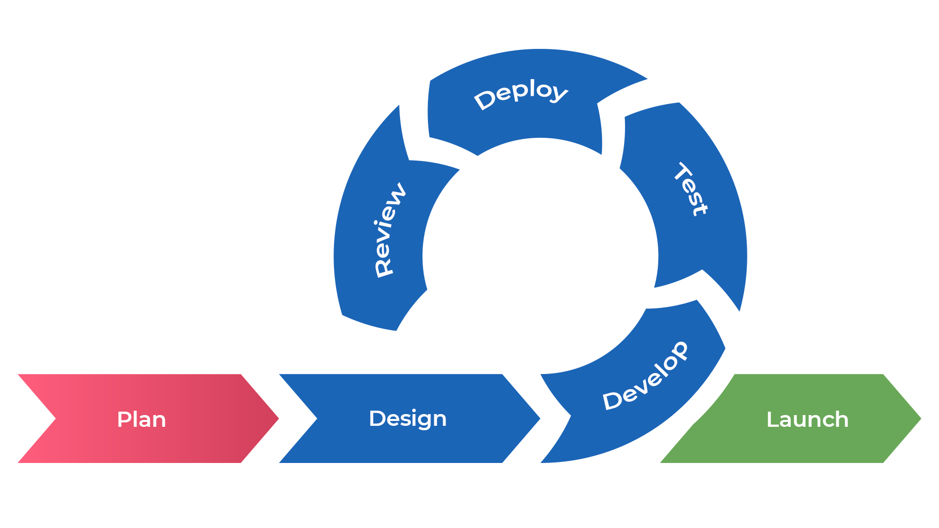
Methodology

Slide 6
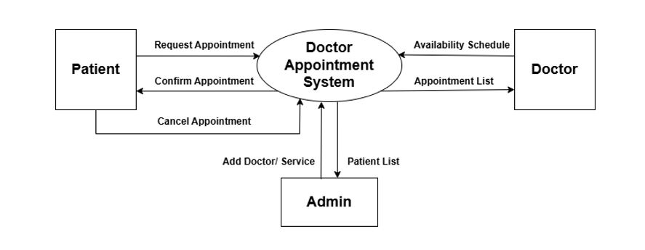
DFD
DFD Level 0

Slide 7
Conclusion
NepHeal is a mobile app that makes it easy to book doctor appointments.
It helps patients and doctors connect without long wait times.
The app is simple to use and improves communication.
It supports better, faster, and more organized healthcare.

Slide 8


Slide 9
check

